Slide 1
C3PR:
An Introduction for Users
A Tool Demonstration from caBIG™
Vijaya Chadaram
Duke Cancer Center
April 29, 2008
Notes:
“Hi! I’m Vijaya chadaram, clinical trials manager from Duke comprehensive cancer center, within caBIG, I’m subject matter expert or domain expert translates to end user
How many end users in the audience?. What tools are used currently?
The purpose of this demo is to provide high level overview of functionality of C3PR for end users (I think the key users), not too technical and also to gather your input on if this tool provides any benefit, user friendly etc. and proposed enhancements.

Slide 2
Agenda and Goal
Overview and Introduction to C3PR
Demonstration of user functionalities
Resources and Next Steps
The goal of this demo is to introduce you to the
capabilities and benefits of C3PR that are available
for adoption from caBIG™. You can also adapt your
existing registration tool to become caBIG™ compatible
or set up your tool to interface with this one.
Notes:
“Today, we will open with a brief overview of the goals of caBIG, to set the stage for the rest of the presentation. Then, we will turn quickly to introducing (name of tool) and reviewing its functionality. Additionally, we will review some additional resources, and next steps for evaluation and selection of the right tool for your organization.”
“The goal of this demo is to show you a caBIG™ tool that is available for adoption. I want to emphasize though, that you have many options, and that you are not restricted to adopting a caBIG™ tool. You can also adapt your existing tool to become caBIG™ compatible, or set up your tool to interface with this one. If the tool we show you today isn’t right for you, we’ll point you to the right places to learn about alternative paths.”

Slide 3
caBIG™ Overview
caBIG™ is an information network enabling all constituencies in the cancer community – researchers, clinicians, patients – to share data and knowledge to accelerate the discovery of new diagnostics and therapeutics, and improve patient outcomes.
caBIG™ Vision
  Connect the cancer research community through a shareable, interoperable infrastructure
  Deploy and extend standard rules and a common language to more easily share information
  Build or adapt tools for collecting, analyzing, integrating and disseminating information associated with cancer research and care
Notes:
“For those new to caBIG, here is a quick view of what the overarching caBIG mission and vision is. When you connect with caBIG, you aren’t just using a tool, you are connecting with a larger community striving to accelerate discovery in cancer research. We want to connect people through a shared infrastructure, make it easier to share information where appropriate, and provide tools that support a life cycle of research and care.”

Slide 4
Introduction to Cancer Central Clinical Participant Registry (C3PR)
Notes:
“Now, let’s turn to the tool we are looking at today: ____ “

Slide 5
Introduction
C3PR Release 1
  Developed by Nortel Solutions
  Baseline functionality for registering patients to pre-defined protocols
  Released for testing in 2004, production in 2006
C3PR Release 2
  Developed by Duke Comprehensive Cancer Center
  Extends the Release 1 functionality
  Project began in November 2006, production in 2008
C3PR Release 3
  Developed by Duke Comprehensive Cancer Center
  Builds upon the functionality in release 2
  Project began March 2008

Slide 6












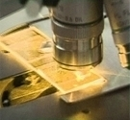


How C3PR fits into the
Research Continuum
C3PR is a web-based application used to manage participants in cancer clinical trials.
Clinical Research
Imaging
Molecular Biology
Pathology
Notes:
C3PR is one in a set of complementary tools called the caBIG™ Clinical Trials Suite (CCTS). Like all of the caBIG™ tools, C3PR plays a specific role in the cancer research continuum – which can be loosely grouped into four categories, Clinical Research, Imaging, Pathology, and Molecular Biology.”
C3PR, is intended at the broadest level to enable _____ (target user group) – to ______ . (Insert single statement about the tool – an example from caArray is provided above).

Slide 7





Where does a participant registry fit in?
Cancer Central Clinical
Participant Registry (C3PR v2)
Patient Study Calendar (PSC)
Eligibility is verified
and patient is registered
to a study
Tracks the patient
throughout the study
Clinical Trial Data
Management Systems (C3D)
Cancer Adverse Event
Reporting System (caAERS)
Patient visits the
Physician
Lab Viewer
Clinical data is captured
Identifies adverse events
and any associated
schedule changes
Identifies labs, loads
them into the CDMS
and AE system
Notes:
After consenting the subject Participant registry or registering a subject to the clinical trial is the first step in connecting subject to a clinical trial.

Slide 8
Using C3PR
Who and Why?
Target Users:
  Registrars that register subjects to studies
  Study Coordinators that monitor study activity and update the study definition
  Site Coordinators that assign studies to Study Coordinators
  Administrators that administer clinical systems
Core Functions / Modules
  Participant Management
  Study Management
  Registration Management
  Reporting
  Integration
Notes:
(Note: The previous slides were primarily big picture about how the tool fits within the landscape – now, we are getting into more concrete information about this specific tool – who would use it, and what is does. In this slide, be specific about the types of users that would use the tool, and a thumbnail sketch about what it actually does. How does the tool fit within a typical users’ workflow? What is the work setting in which tool use would occur? After and before, or in support of, what activities?)

Slide 9
More on How C3PR Benefits Your Research
Participant Management
  Investigators, study personnel, treating physician, subjects
Study Management
  Study structure, diseases, notifications, blinded studies
Registration Management
  Consent, eligibility, stratification, randomization, enrollment
Reporting
  Registrations, protocols
Integration
  Exchange study definition and registrations with multi-site C3PR and CCTS
Notes:
Participant Management: This component will manage all aspects of the participant data including address, contact information, searching, synchronization with external systems and relations management.
Protocol Management: C3PR Release 2 will allow for searching of protocols, registration history. C3PR does not aim to be the primary protocol management system, however it contains basic Protocol information.
Registration Management: Complete registration management will be provided within the C3PR system including stratification, assignment to protocol arms with and without randomization. The Release 2 system will also provide for integration of registration status information with the Lab Hub, Patient Study Calendar and other CTMS systems.
Eligibility Criteria Management: The new C3PR system will continue to support the optional import, review and approval process of the eligibility criteria. this support will include distinct eligibility checklists for different phases (or epochs) of the same protocol.
Clinical Data Access: C3PR will provide direct access to clinical data in C3D (and other clinical data management systems) for the selected patient on the selected protocol.

Slide 10
More on How C3PR Benefits Your Research
Integrate with other clinical systems
  caBIG Clinical Trials Suite
    Patient Study Calendar (PSC)
    Cancer Adverse Events Reporting System (caAERS)
    Cancer Clinical Database (C3D)
    LabViewer/CTODS
  Multi-site Trials
    Coordinating site exchanges study definition
    Affiliate sites exchange registration information
    Coordinating site randomizes and enrolls subjects

Slide 11
Demonstration of C3PR
Notes:
“Now, let’s take a closer look at the tool itself. “

Slide 12
Key Functions for Demo
Review a Study
Add a Subject
Register a Subject
Manage a Registration
Review other functions
Adopters of C3PR
  Duke University
  Wake Forest University
Notes:
Speaker: On this slide, quickly preview the workflow elements that you are going to present, focusing on why a user would be interested – e.g., the scientific problem or need it addresses. Make sure that the demo that follows clearly maps to this preview, so that people can see the link between the demonstration and the workflow element it addresses.

Slide 13
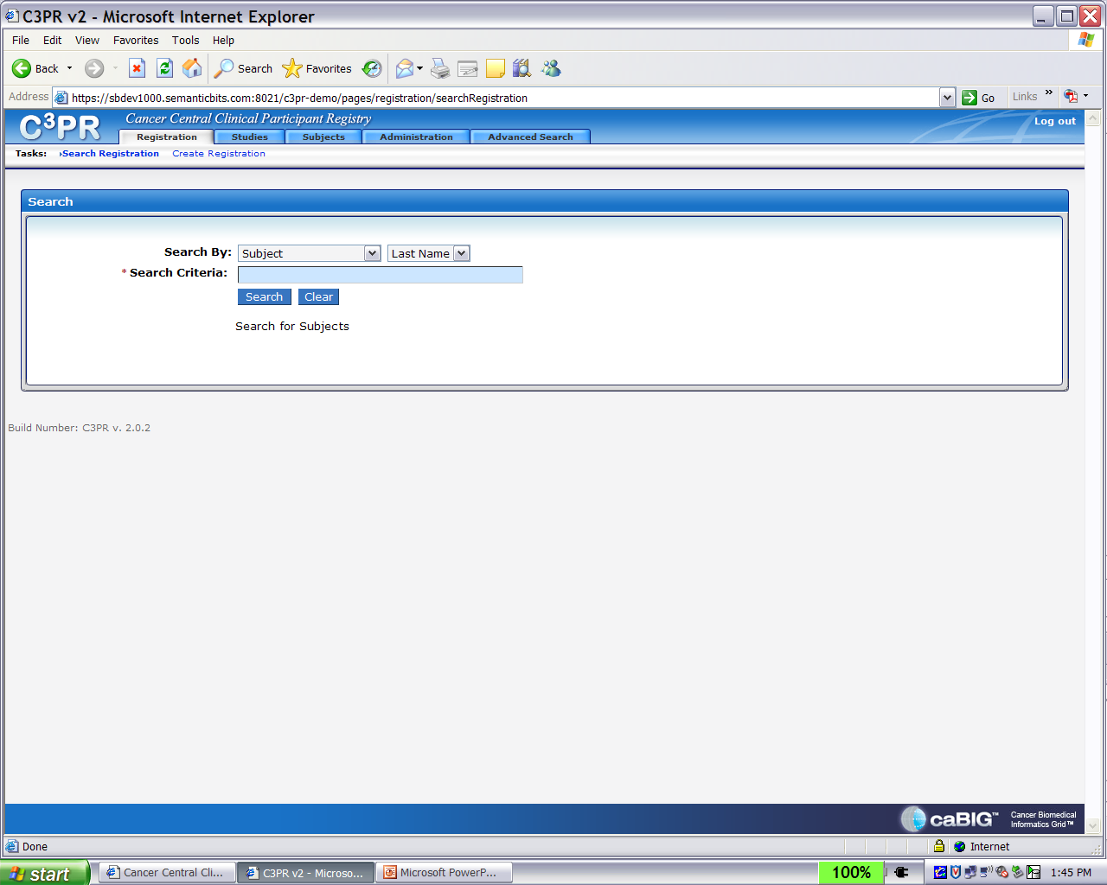
C3PR Navigation Bar

Slide 14
A Quick Review: Key Functions and Benefits of (Tool Name)
Participant Management
Investigators, study personnel, treating physician, subjects
Study Management
Study structure, diseases, notifications, blinded studies
Registration Management
Consent, eligibility, stratification, randomization, enrollment
Reporting
Registrations, studies
Integration
Exchange study definition and registrations with multi-Key Functionality
Clarifying Tool Boundaries. No tool meets all user expectations. Here are some functions that are outside the scope of this tool.
Managing the history of study definitions
Managing the activities associated with subjects on studies (e.g. calendar)
Managing clinical data
Notes:
“Here’s a summary of the tool’s key functions and benefits we just reviewed. . We also want to clear on what the tool does not do that you might get questions about. Here are some tool boundaries, to help you have an honest discussion with potential users in your organization about whether this tool is right for them. caBIG has an active development community, so if you have a specific need that the tool does not currently fill, there are forums for raising your concern to those guiding future development efforts. With the right internal or contract staff, you could even extend the tool to meet those specific needs on your own.”

Slide 15
Getting Started:
A Glance at the Technology
Tool Platform: web application hosted by an institution or NCI – requires a web browser for end user access
Key Prerequisites: database (Oracle or Postgres), application container (Tomcat), Java
End User Readiness: administrators installing C3PR will require familiarity with databases and web applications; users of C3PR will require basic clinical knowledge and several hours of training/orientation
Notes:
(This is a BRIEF technology lay of the land, just so people understand how this works, and the possible investment/ learning curve needed to get going.) KEEP IT FOCUSED ON WHAT THE TYPICAL USER NEEDS TO KNOW OMLY!!

Slide 16
Resources and Next Steps
Notes:
“Let’s take a look at the next steps and resources that can help you get started on the path to adopting (tool name).”

Slide 17
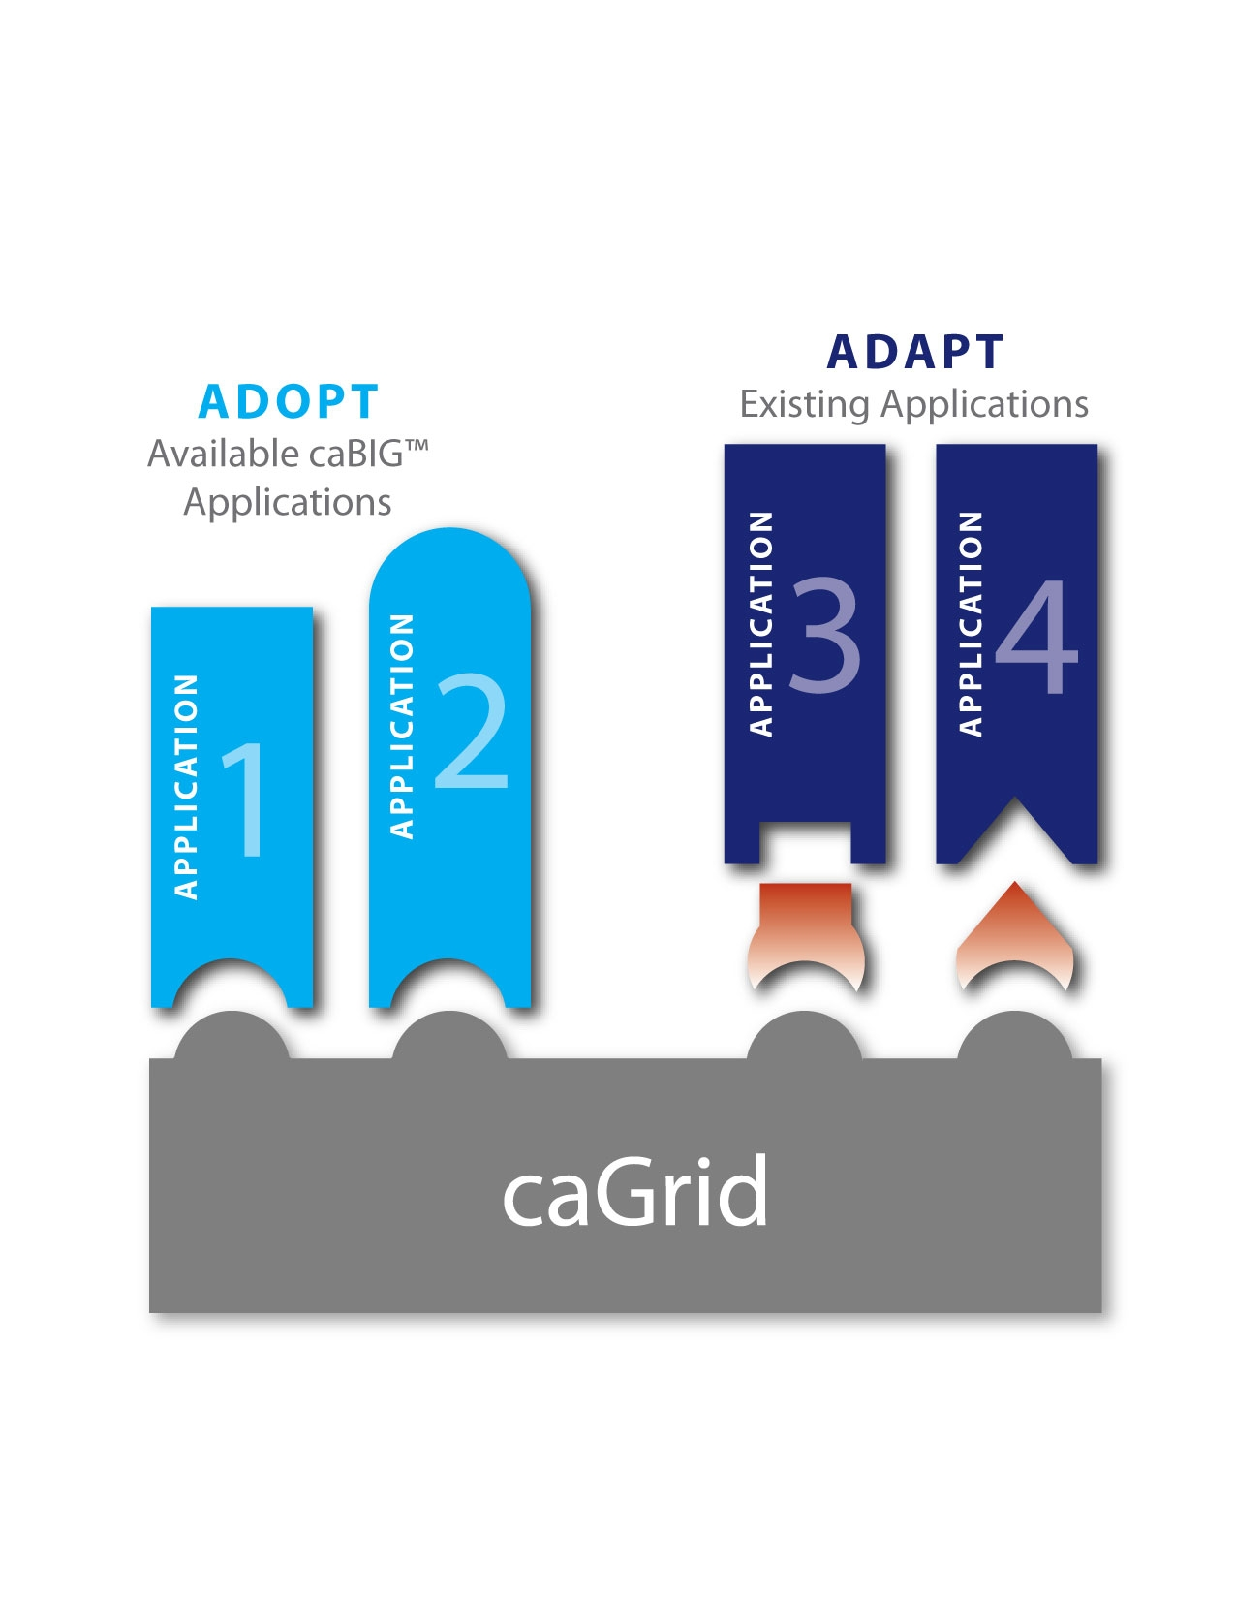
Two Pathways: Adopt or Adapt
Interested organizations are not required to adopt this caBIG™ application to connect with caBIG™
There are other ways to share data and use common data elements and controlled vocabularies by adapting current or non-caBIG™ applications
Notes:
“As we said at the start of this presentation, adopting this tool is one way to connect with caBIG. You also have the option of adapting your own tool to be compatible with caBIG standards and infrastructure. This presentation has been about adopting this specific tool – other presentations available from caBIG can tell you more about the adapt path.”

Slide 18
Adopting C3PR
Release Timeline and Future Plans
Release Information
Current Version Number: 2.0
Release Date: March 2008
caGrid Enabled
Development Schedule
Release 2.5 in September, 2008 and release 3.0 in March, 2009
Planned enhancements include companion protocols; further integration with CCTS, OPEN, and RSS; enhanced reporting such as Summary 3/4; customization to fields and diseases; hosted mode; etc.
Development is active with requirements gathering from adopters (Duke, Wake), elaborators (Mayo, CALGB, Westat), caBIG, and the cancer research community
Support Available
ncicb@pop.nci.nih.gov
Notes:
“If this tool looks right for you, here’s some information about the current release and future development plans. There’s also some information about the support that’s available if you are seeking an external resource for help. caBIG is continuing to grow, so it’s expected that additional support resources will become available as we proceed – there’s information about the caBIG Enterprise Support Network on the caBIG community website that will ell you more about these options.”

Slide 19
Resources for C3PR
C3PR Online | https://cabig.nci.nih.gov/tools/c3pr
Tool Landing Page | https://cabig.nci.nih.gov/tools/c3pr
Access to Demo Passwords and Logins | URL: https://sbdev1000.semanticbits.com:8021/c3pr-demo/public/login User: c3pr_admin Password: c3pr_admin
Software Development Project Site | http://gforge.nci.nih.gov/plugins/scmcvs/cvsweb.php/c3prv2/?cvsroot=c3prv2#dirlist
(Insert LISTSERV Name) LISTSERV Signup | See Gforge above
Contact | Pankaj Agarwal: p.agarwal@duke.edu
NCI Center for Bioinformatics Applications Support | ncicb@pop.nci.noh.gov
Notes:
“Here are some critical URL’s and e-mail addresses to get you started – the Tool Landing page is where the most recent release and documentation and training for the tool is kept, so it’s a great starting place.”

Slide 20
Thanks for Attending!
We’d like to know what you think!
  Did you get useful information from this presentation?
  What additional information or future presentation topics would you like to see?
Send your feedback to caBIGconnect@cancer.gov
Notes:
“Thanks for listening to this presentation – we’d like your feedback! Here are some questions to get you started – send us a quick note at the e-mail below so we can continue to develop new materials that will support your needs. I’ve enjoyed talking with you – and wish you all the best as you connect with caBIG!”

